Slide 1
HappyNess
Country’s Happiness Predictor

Slide 2

Introduction
HappyNess is an AI based project which uses the K- Nearest Neighbours model to Predict whether a country is happy or not based on 6 parameters from the World Happiness Report:
Log GDP per capita, Social support ,Healthy life expectancy at birth, Freedom to make life choices,Generosity and Perceptions of corruption.

Slide 3
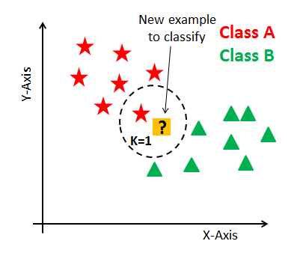
K Nearest Neighbour Model
K Nearest Neighbour is a simple algorithm that stores all the available cases and classifies the new data or case based on a similarity measure. It is mostly used to classify a data point based on how its neighbours are classified.

Slide 4
How does the program work?
The K Nearest Neighbour model was trained with data from 81 countries to understand which parameters are of how much importance.
Once it is trained, the user can input any values from their country to know whether it is happy or not relative to the other countries.

Slide 5
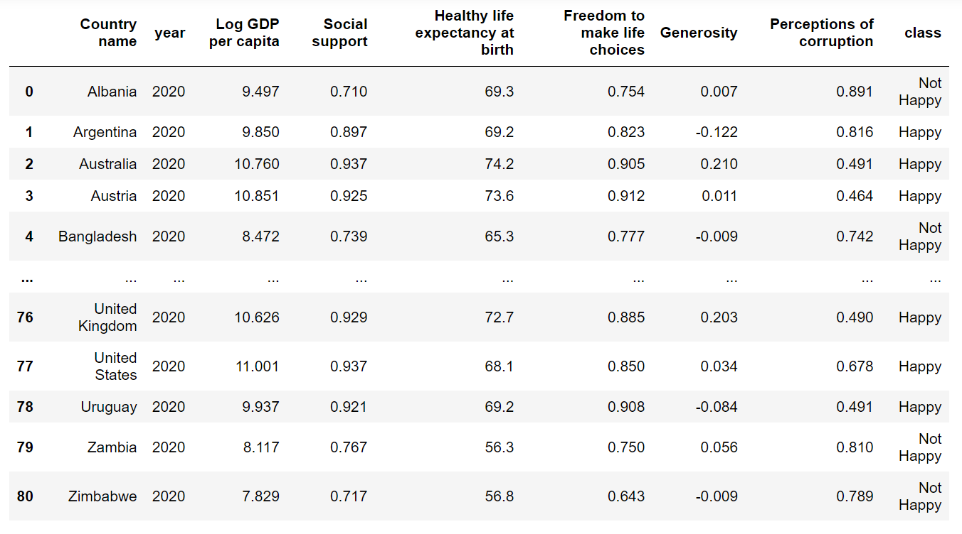

Slide 6
Let’s now execute the program!

